Slide 1

Rights Respecting Schools
Rights Respecting Overview

Slide 2

What is rights respecting?
It is based on the United Nations Convention on the Rights of the Child (CRC). There are 54 children’s rights in the UNCRC.
At Whitleigh Primary we have picked 9 key articles to focus on. These were picked using a diamond 9 activity when our RRSA journey first began. We revisit these and ensure they are still our key 9.
The Award recognises achievement in putting the CRC at the heart of a school’s practice to improve wellbeing and help all children and young people realise their potential.

Slide 3
Our 9 key Articles…

Slide 4

Article 12
We have a right
to give our
opinions and
for them to
be respected.

Slide 5

Article 13
We have a right
to share our ideas
and be heard.

Slide 6

Article 15
We have a right to join clubs and groups.

Slide 7

Article 17
We have a right
to information.

Slide 8

Article 19
We have a right
to be safe.

Slide 9

Article 24
We have a right
to a safe
environment.

Slide 10

Article 28
We have a right
to an education.

Slide 11

Article 21
We have a right
to become the best
that we can be.

Slide 12

Article 31
We have a right
to rest, relax
and play.

Slide 13
How do we use these articles?
Class Charters (which replace class rules) are based on the CRC. Classes work together in September to choose which articles they base their charters on. Each member of the class signs the charter.
The Articles form the basis of our behaviour policy, and adults and children can regularly be heard using the language of rights.
Stickers are given out on Wednesday lunchtimes by our Rights Rangers when they see children ensuring children’s rights are upheld.
We discuss relevant articles in any lessons, they often crop up in History and RE lessons!
Our Assemblies always have a Rights Focus.
School displays are linked to the relevant article.

Slide 14
dutybearers
Children at Whitleigh Primary School are aware of the role of Duty Bearers. They also know that they are Rights Holders. The children know that all adults are Duty Bearers, but we have posters on each classroom door to remind us. The Rights Rangers made a fun video to remind us who our Duty Bearers are, and showed it in assembly. You can check out this video on our website!

Slide 15
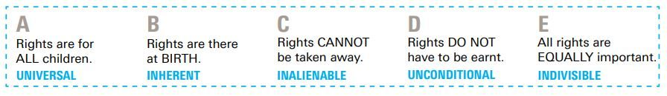
ABCDE of Rights
All children are taught about the ABCDE of Rights.
They can name some or all of the ABCDE.
These are displayed in every classroom and referrenced.

Slide 16
The rights rangers
A group of children from each class who meet to ensure children’s rights are upheld and we are putting the CRC at the heart of all that we do.
Their main goal is to be the voice of the children and support the children with the concept of Rights.
We meet regularly to discuss our action plan and next steps. The children Rangers bring ideas from their classes to our meetings, and have time to feedback to their classmates.

Slide 17
Citizenship Week
Each Autumn term we hold a Citizenship week. We use the OutRight campaign from Unicef to base all our learning on.
In Autumn 2021 the focus was on mental health and wellbeing. We had a very successful week finding out more with Paddington Bear (Unicef’s mascot).
This year the OutRight campaign is focussing on Article 24, and we can’t wait to get involved!

Slide 18
Opportunities for our children
When planning our curriculum, teachers link any learning to children’s rights using the CRC articles. This is particularly evident in Topic and RE lessons.
Articles are explored in weekly assemblies.
Articles are explored in PSHE lesson and daily newsround time.

Slide 19
in classes
Each class displays their Class Charter, there are lots of lovely imaginative displays around our school.
Our Dutybearers are displayed on each classroom door.
ABCDE of Rights is displayed in each classroom.
The language of Rights is used everyday.

